Slide 1

USAT WTCS Overview Erika Ackerlund

Slide 2
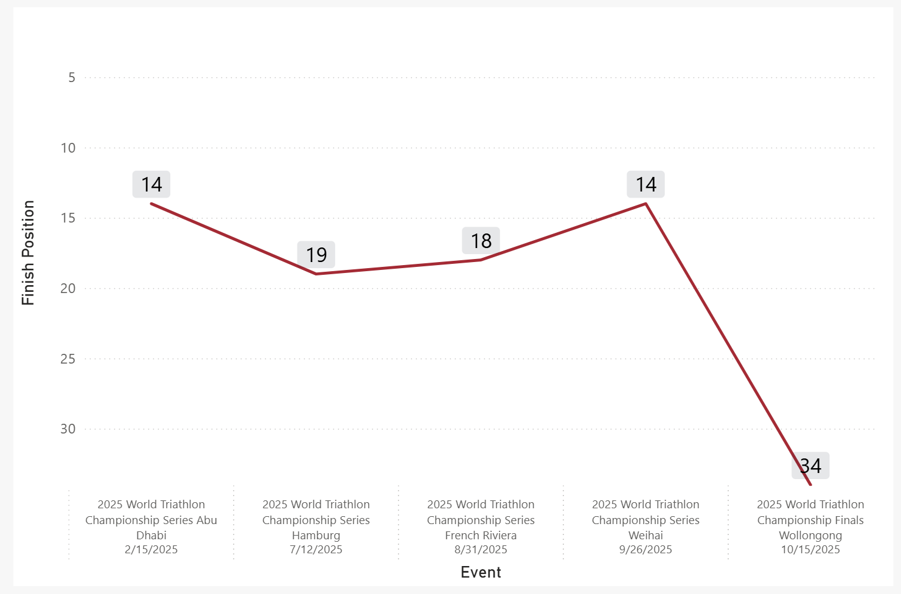
Individual Focus
WTCS Overview
Erika achieved two top 15 finishes on the WTCS series helping boost her average result within the Top 20
WTCS Result by Event
Average Result
A
19.8
Note: 2025 WTCS completed events
Notes:
shape
No alt text provided
pageNavigator
No alt text provided
Gap to Lead by Stage
No alt text provided
Name
No alt text provided
Place Change by Stage
No alt text provided
Place at Stage
No alt text provided
pivotTable
No alt text provided
slicer
No alt text provided
slicer
No alt text provided
shape
No alt text provided
Key Point
No alt text provided
Recent Performance
No alt text provided
image
No alt text provided

Slide 3
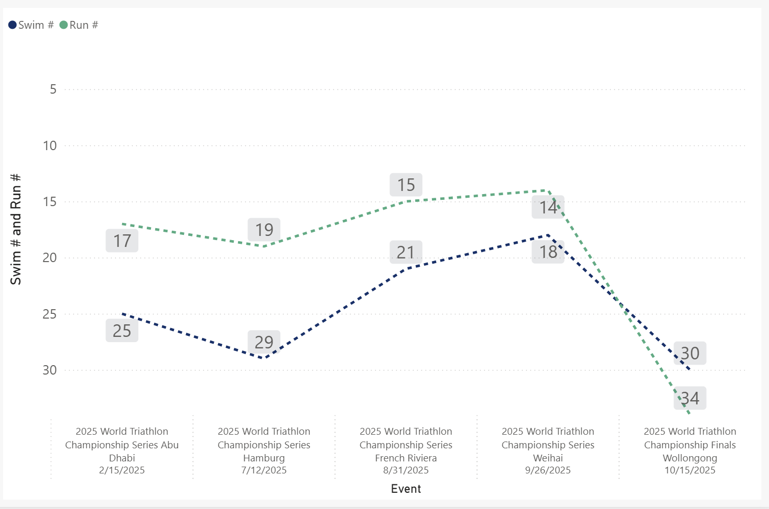
Individual Focus
WTCS Run and Swim Overview
Outside of the WTCS finals Erika had 4/5 top 20 run splits
Erika’s best swim and run occurred at Weihai achieving 14th and 18th respectively
WTCS Swim and Run Rank by Event
Average Swim Rank
Average Swim %
Average Run Rank
Average Run %
24.6
35.1
19.8
47.3
Note: 2025 WTCS completed events
Notes:
shape
No alt text provided
pageNavigator
No alt text provided
Gap to Lead by Stage
No alt text provided
Name
No alt text provided
Place Change by Stage
No alt text provided
Place at Stage
No alt text provided
pivotTable
No alt text provided
slicer
No alt text provided
slicer
No alt text provided
shape
No alt text provided
Key Point
No alt text provided
Recent Performance
No alt text provided
image
No alt text provided

Slide 4
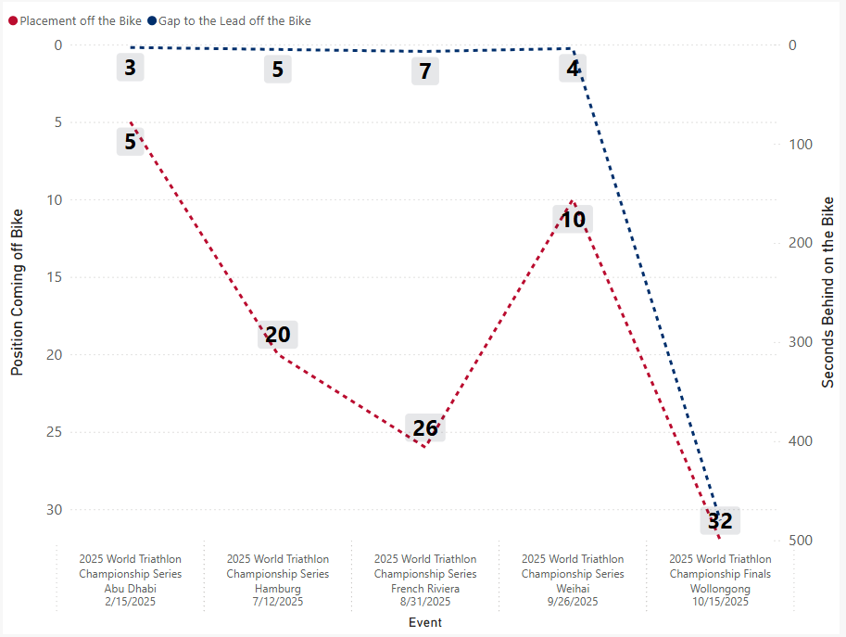
Individual Focus
WTCS Bike Overview
At the WTCS Finals, Erika exited the swim outside the front bike groups, resulting in a larger time gap to the lead compared to earlier races
WTCS Bike Positioning
Average Position off the Bike
18.6
-480 seconds
Note: 2025 WTCS completed events;
Notes:
shape
No alt text provided
pageNavigator
No alt text provided
Gap to Lead by Stage
No alt text provided
Name
No alt text provided
Place Change by Stage
No alt text provided
Place at Stage
No alt text provided
pivotTable
No alt text provided
slicer
No alt text provided
slicer
No alt text provided
shape
No alt text provided
Key Point
No alt text provided
Recent Performance
No alt text provided
image
No alt text provided

Slide 5
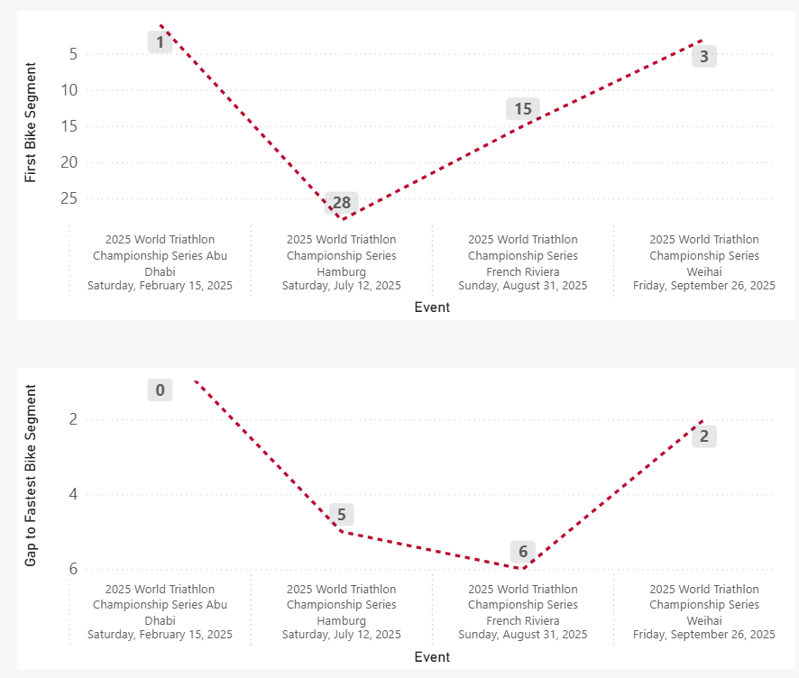
Individual Focus
WTCS First Bike Split Analysis
Erika had the fastest first bike split at Abu Dhabi
In 2/4 races, Erika had a top 5 first bike split.
WTCS First Bike Split Rank
WTCS First Bike Split Gap to the Leader
Note: (1) 2025 WTCS completed events;
(2) First Bike Split determined as the first bike lap in the WTCS race. Most races this is the first half lap, but for those without a half lap counter it is the first entire lap.
Notes:
shape
No alt text provided
pageNavigator
No alt text provided
Gap to Lead by Stage
No alt text provided
Name
No alt text provided
Place Change by Stage
No alt text provided
Place at Stage
No alt text provided
pivotTable
No alt text provided
slicer
No alt text provided
slicer
No alt text provided
shape
No alt text provided
Key Point
No alt text provided
Recent Performance
No alt text provided
image
No alt text provided

Slide 6
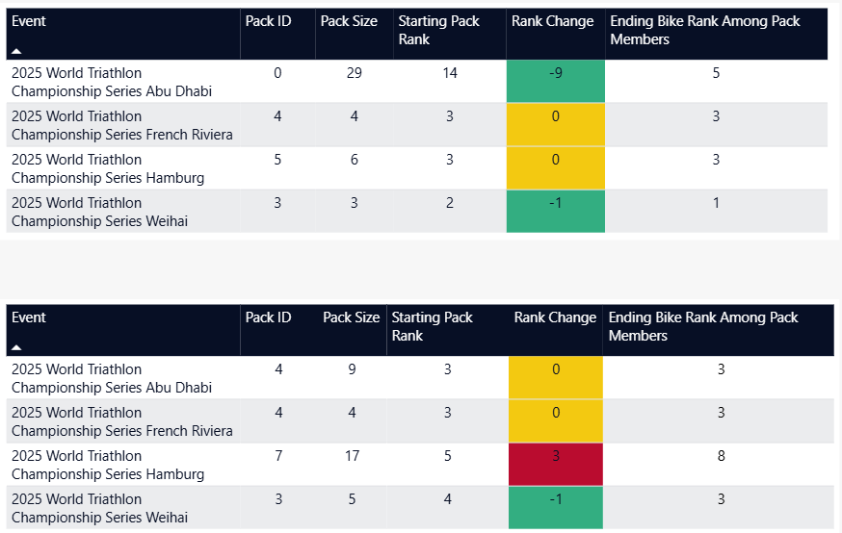
Individual Focus
WTCS Relative Bike Positioning (Swim Group)
Relative to those Erika started the bike with at the first half lap she either maintained pack position or moved up in 4/4 races
WTCS Bike Positioning (First Bike Group)
WTCS Bike Positioning (Swim Group)
Note: (1) 2025 WTCS completed events;
(2) Top Chart Shows the Athlete’s performance relative to those around themselves when the first bike checkpoint is used to determine what packs athletes are riding in. Bottom Chart also shows relative performance, but when the swim exit checkpoint is used for pack calculations.
A pack is defined as a continuous group of athletes with no more than 2 seconds separation between each member of the group.
Notes:
shape
No alt text provided
pageNavigator
No alt text provided
Gap to Lead by Stage
No alt text provided
Name
No alt text provided
Place Change by Stage
No alt text provided
Place at Stage
No alt text provided
pivotTable
No alt text provided
slicer
No alt text provided
slicer
No alt text provided
shape
No alt text provided
Key Point
No alt text provided
Recent Performance
No alt text provided
image
No alt text provided

Slide 7
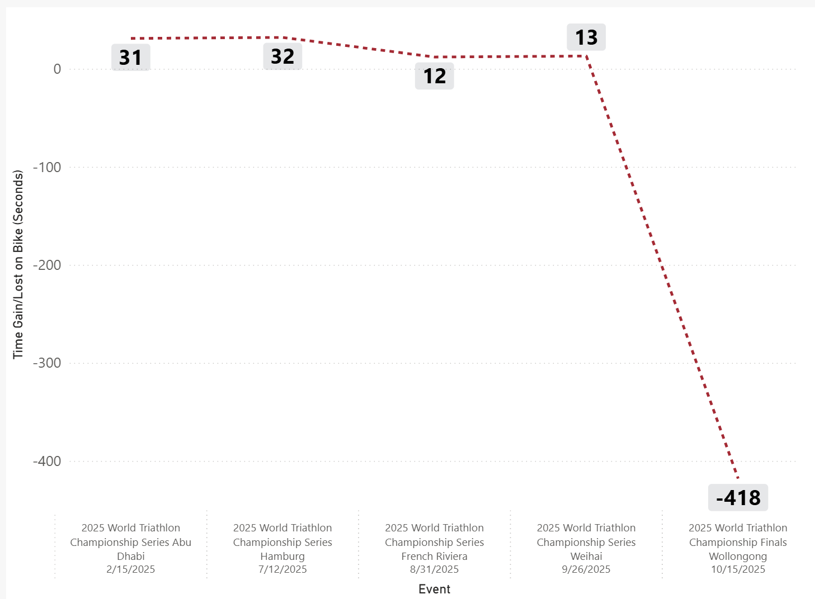
Individual Focus
WTCS Bike Overview
At the WTCS Finals, Erika exited the swim outside the front bike groups, resulting in a larger time gap to the lead compared to earlier races
WTCS Gap to Leader Change From Swim to Bike by Event
Average Gap Change from Swim to Bike (sec)
-66
Note: 2025 WTCS completed events;
Negative represents time lost,
Positive represents time gained
Notes:
shape
No alt text provided
pageNavigator
No alt text provided
Gap to Lead by Stage
No alt text provided
Name
No alt text provided
Place Change by Stage
No alt text provided
Place at Stage
No alt text provided
pivotTable
No alt text provided
slicer
No alt text provided
slicer
No alt text provided
shape
No alt text provided
Key Point
No alt text provided
Recent Performance
No alt text provided
image
No alt text provided

Slide 8
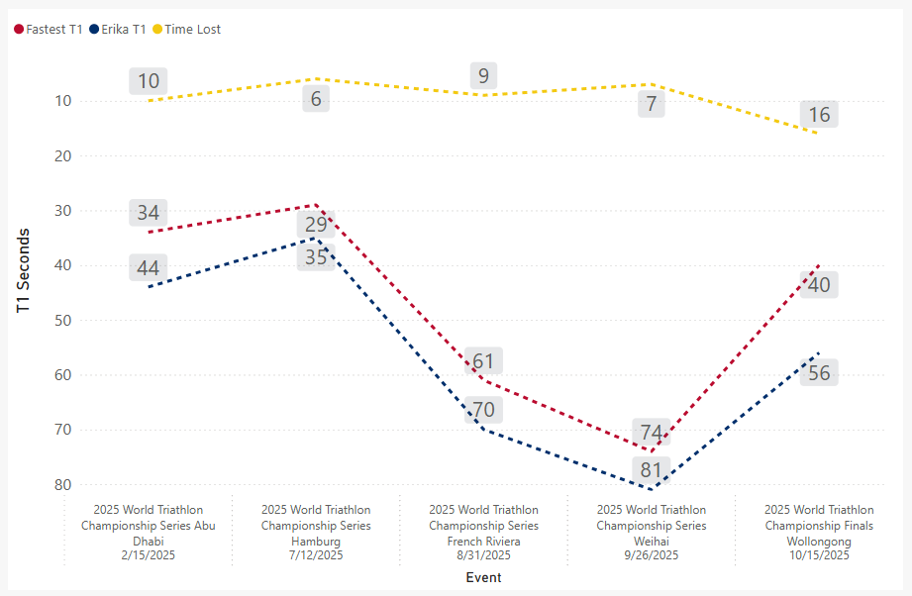
Individual Focus
WTCS Transition 1 Overview
Erika lost less than 10 seconds in 3/5 races
Erika averaged a T1 ranking of 22.8 across the season
WTCS T1 Overview
Average T1 Rank
Average T1 %
Average T1 Time Lost
22.8
41.8
-9.6
Note: 2025 WTCS completed events
Notes:
shape
No alt text provided
pageNavigator
No alt text provided
Gap to Lead by Stage
No alt text provided
Name
No alt text provided
Place Change by Stage
No alt text provided
Place at Stage
No alt text provided
pivotTable
No alt text provided
slicer
No alt text provided
slicer
No alt text provided
shape
No alt text provided
Key Point
No alt text provided
Recent Performance
No alt text provided
image
No alt text provided

Slide 9
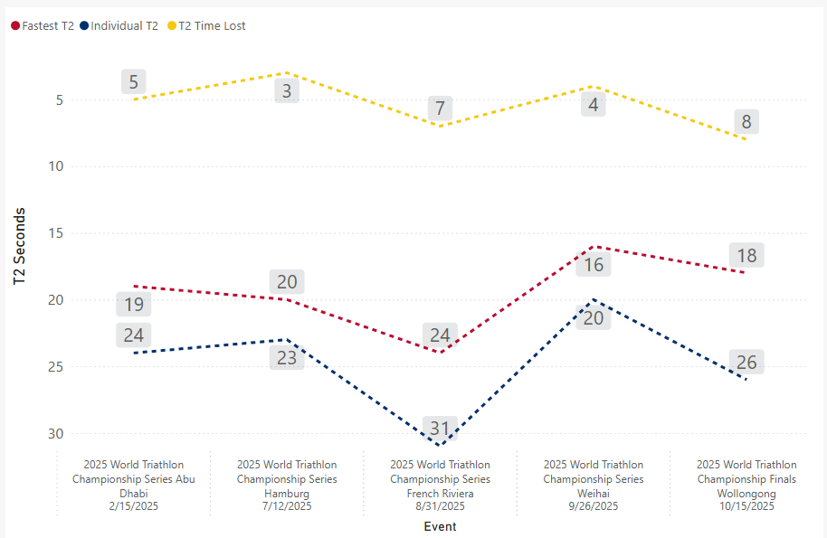
Individual Focus
WTCS Transition 2 Overview
Erika lost less than 10 seconds in 5/5 races
Erika averaged a T2 ranking of 13.4 across the season
WTCS T2 Overview
Average T2 Rank
Average T2 %
Average T2 Time Lost
13.4
67.0
-5.4
Note: 2025 WTCS completed events
Notes:
shape
No alt text provided
pageNavigator
No alt text provided
Gap to Lead by Stage
No alt text provided
Name
No alt text provided
Place Change by Stage
No alt text provided
Place at Stage
No alt text provided
pivotTable
No alt text provided
slicer
No alt text provided
slicer
No alt text provided
shape
No alt text provided
Key Point
No alt text provided
Recent Performance
No alt text provided
image
No alt text provided

Slide 10
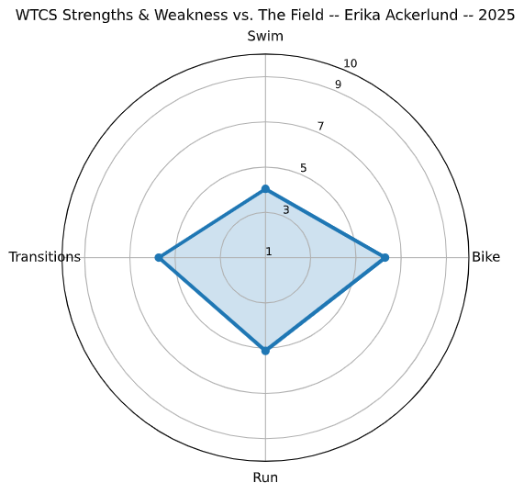
Individual Focus
WTCS Relative Performance Profile
Relative WTCS scores indicate Erika’s bike performance ranked highest among disciplines, while swim performance ranked lowest relative to WTCS fields in 2025
4.0
5.7
6.3
Note: Scores are scaled 1–10 relative to WTCS competition.
Example:
A swim score of 5/10 means that the athletes average swim was faster than half of the field and slower than half of the field.
In contrast a run score of 10/10 would represent having the top run split in every race at the WTCS level.
Transitions are calculated by combining the times from T1 and T2
5.1
Notes:
shape
No alt text provided
pageNavigator
No alt text provided
Gap to Lead by Stage
No alt text provided
Name
No alt text provided
Place Change by Stage
No alt text provided
Place at Stage
No alt text provided
pivotTable
No alt text provided
slicer
No alt text provided
slicer
No alt text provided
shape
No alt text provided
Key Point
No alt text provided
Recent Performance
No alt text provided
image
No alt text provided

